Slide 1
DEVELOPING A FOOD-DONATION AND SHARING MOBILE APPLICATION TO CURB HUNGER CRISIS
TITLE:
Benjamin L. Ollennu
Samuel K. Sarpong
Department of Computer Science
College of science

Slide 2
Introduction
Since 2019, the number of people experiencing acute food insecurity has increased from 135 million to 345 million, meaning that as many as 828 million people go to bed hungry every night. A total of 50 million individuals in 45 different nations are on the verge of going hungry.
Almost one-third, of the food produced annually for human consumption worldwide is lost to waste. The majority of people are unaware of the amount of food they waste every day, including uneaten leftovers, perishable foods, and fruit and vegetable portions that may be repurposed.

Slide 3
Aim
In order to reduce food waste, combat world hunger, and promote good health and wellbeing around the world, this initiative intends to propose a mobile platform for people, organizations, or food merchants to connect and share meals and leftovers with people living in hunger-stricken places.

Slide 4

Methods used in building the system
The system was built based on the android architecture.
Android Studio and Android SDK was the environment used to facilitate the building of the system.

Slide 5


Methods used in building the system(cont..)
Plugins were made available for the development of the application using the Flutter SDK.
Both the application's front end and back end are programmed using Dart provided by the Flutter SDK as well.

Slide 6

Methods used in building the system (cont…)
The online database used to store user and application data and verify user credentials was Flutter Firebase by Google.

Slide 7
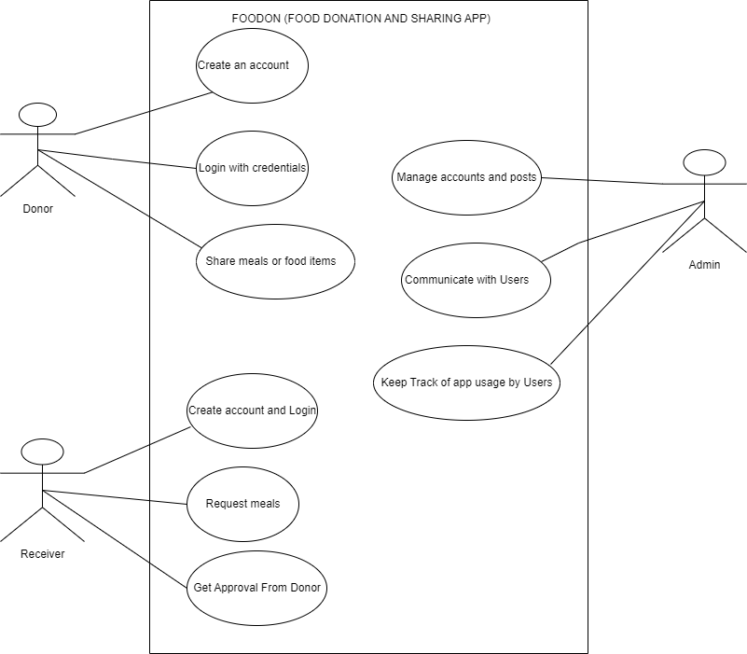
Simplified Use Case Diagram

Slide 8
Functionalities of the app
User Functionalities:
Require log in credentials to use the app.
Personalize profiles.
Share meals or food items.
Send an acceptance request to indicate interest in a specific post.
Request meals or food items.
Make an offer to users requesting for food items or meals.
Communicate in-app.
Report posts and other users.
Review and rate other users.
Specify whether they identify as an individual or an organization.
Send a feedback to developer for app improvement.

Slide 9
Functionalities of the app
Admin Functionalities:
Require log in credentials to use the app.
Handle reported posts and account.
Keep track of the app usage by users.
Handle feedbacks from users.
View application statistics.

Slide 10
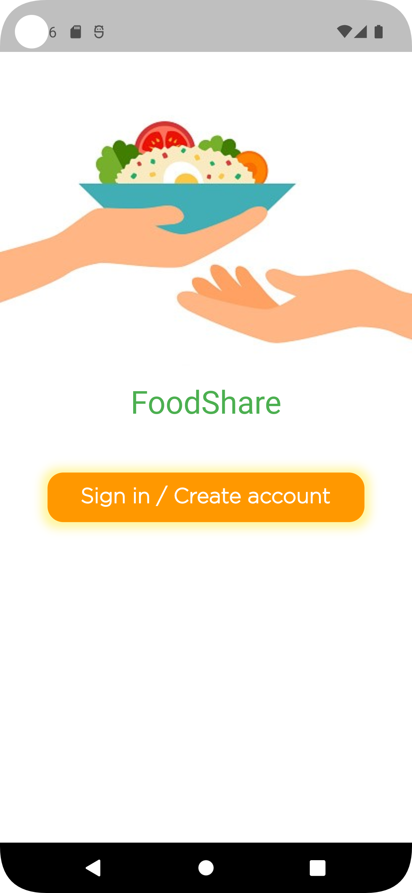
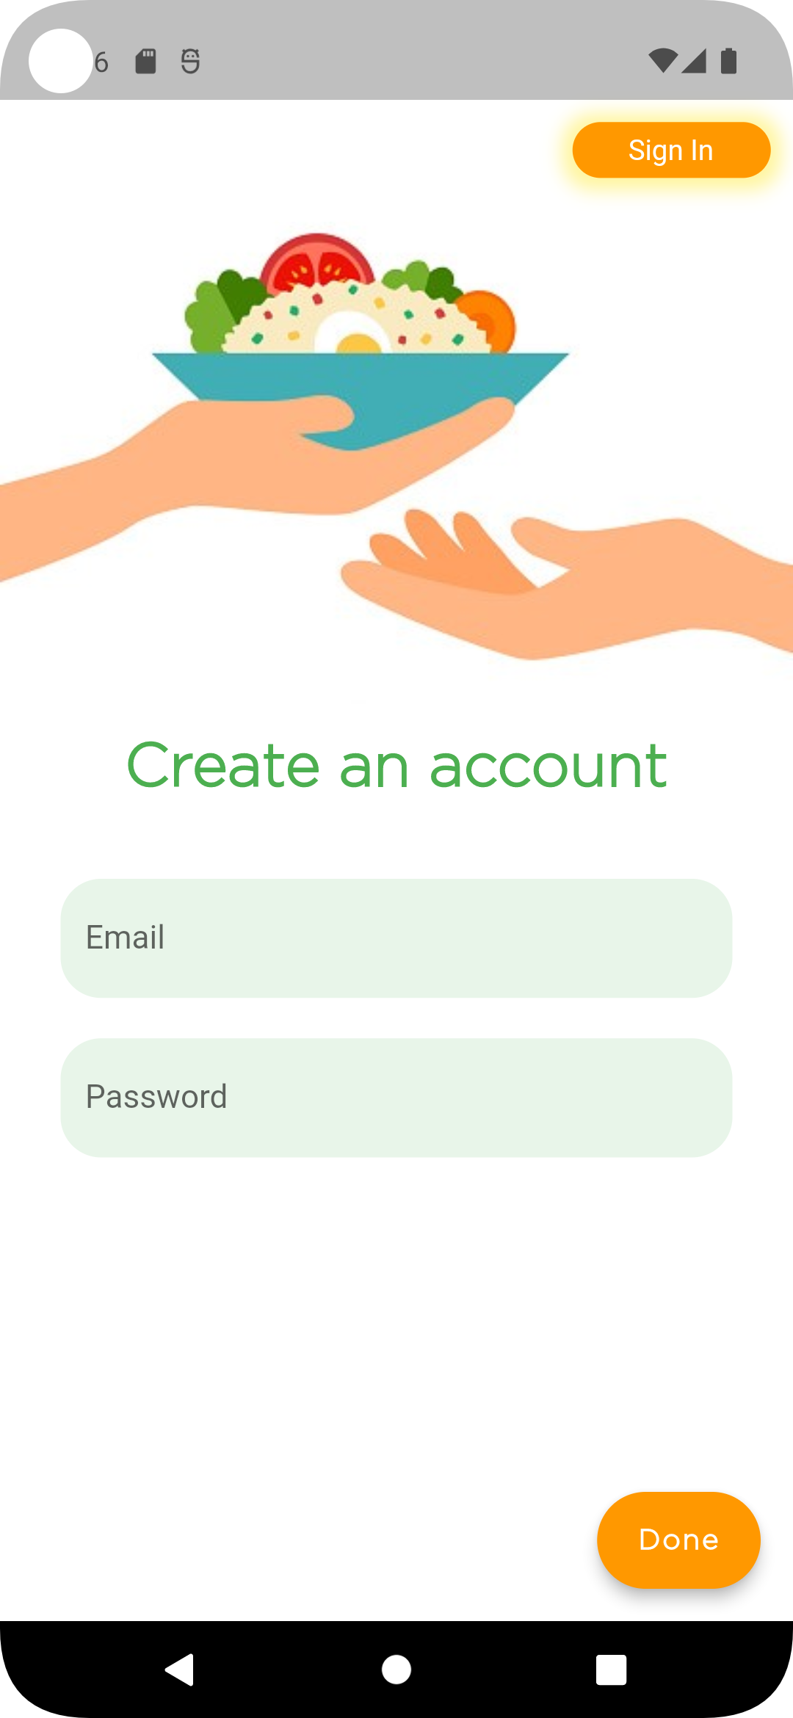
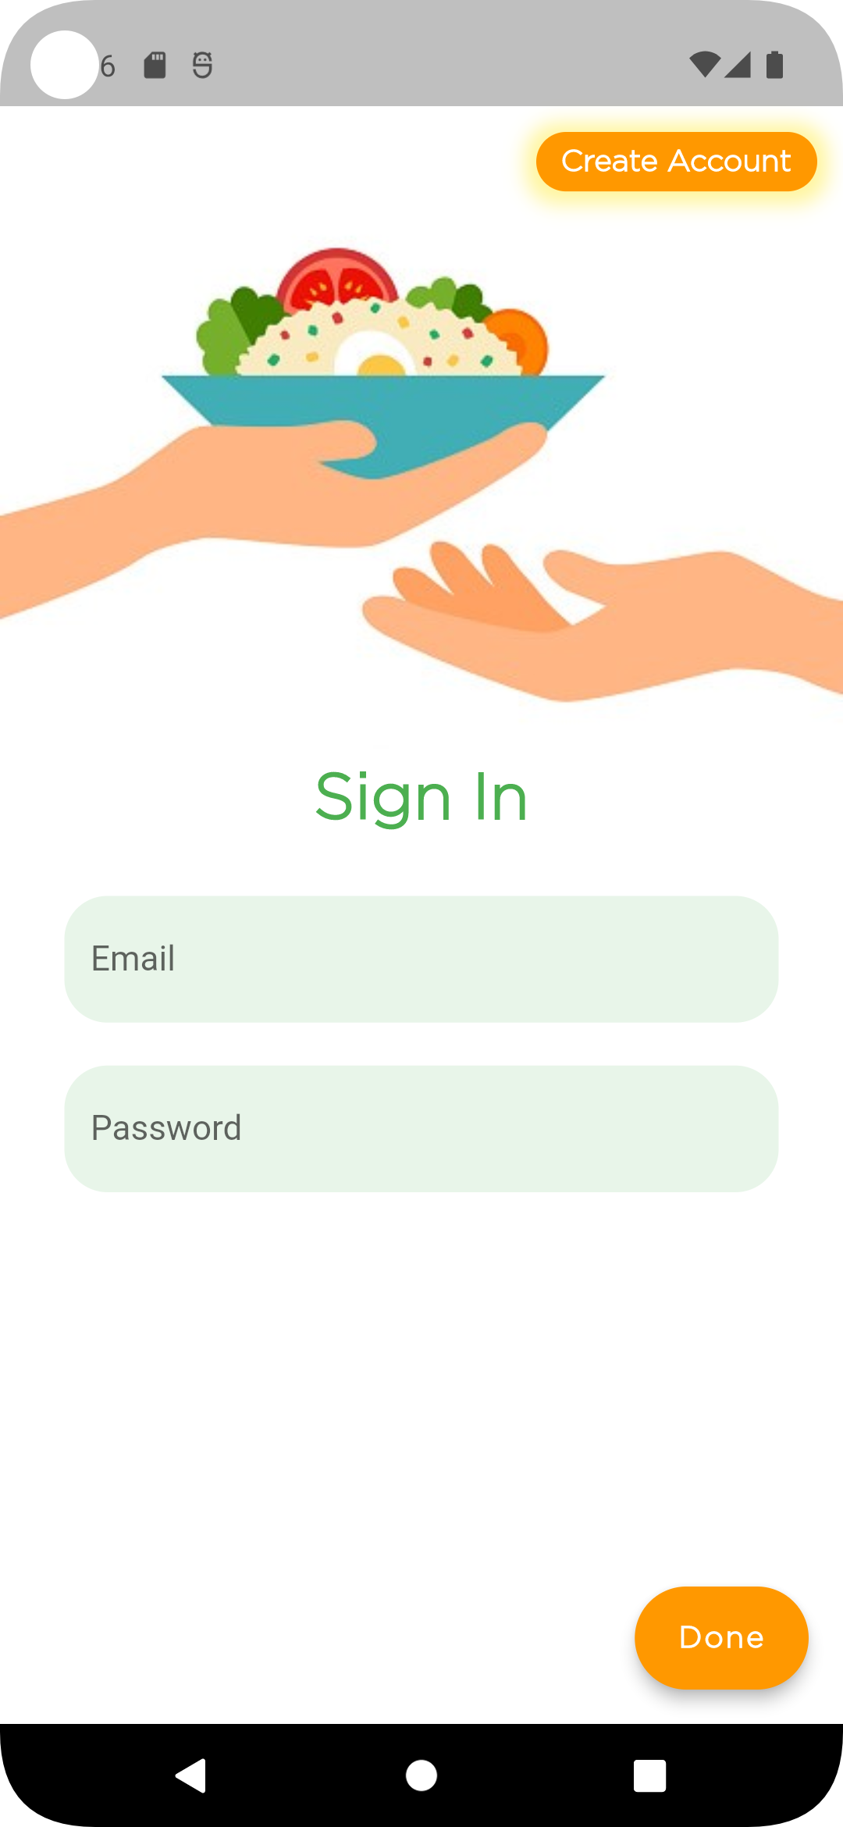
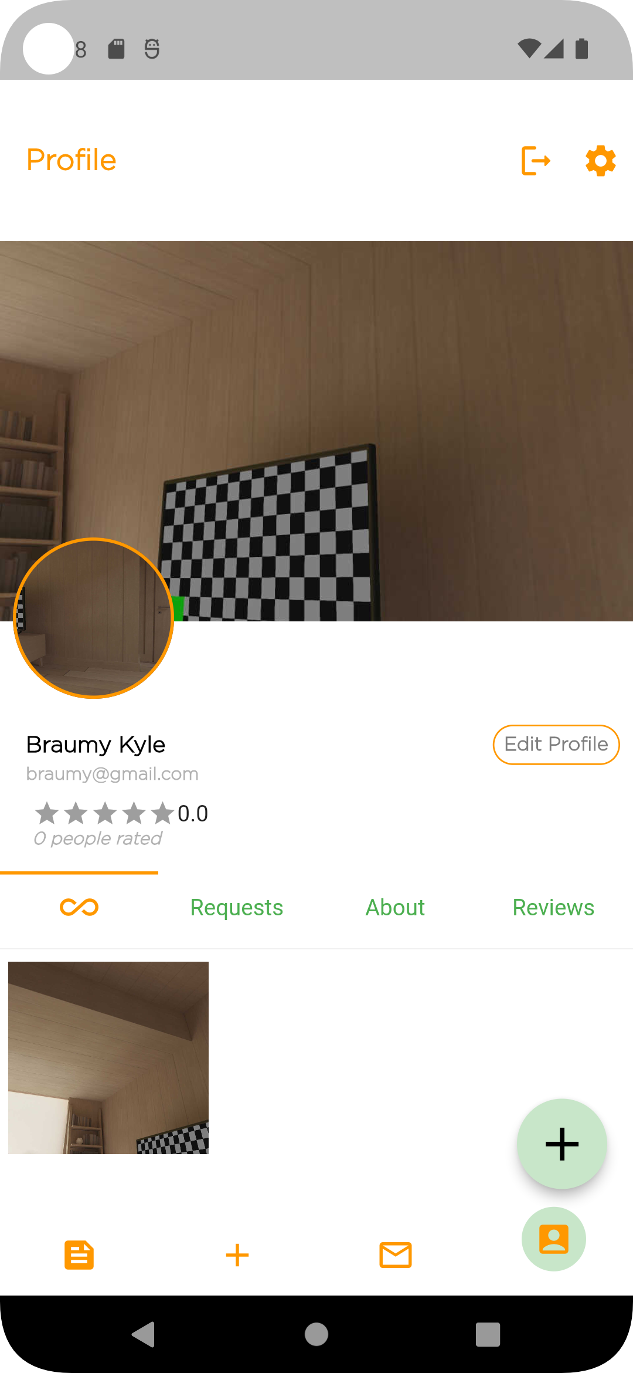
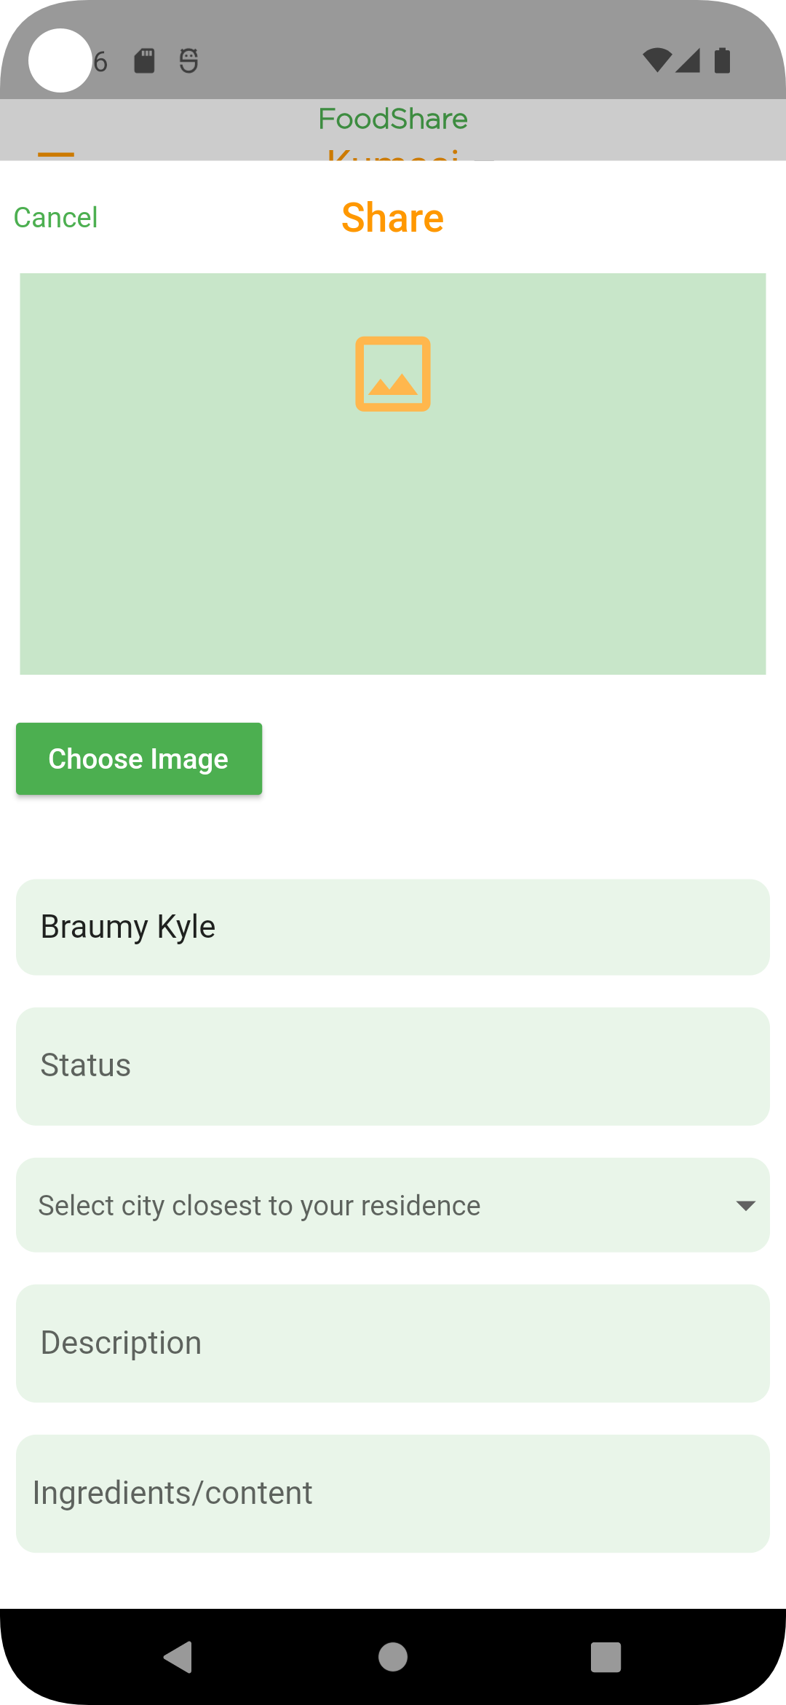
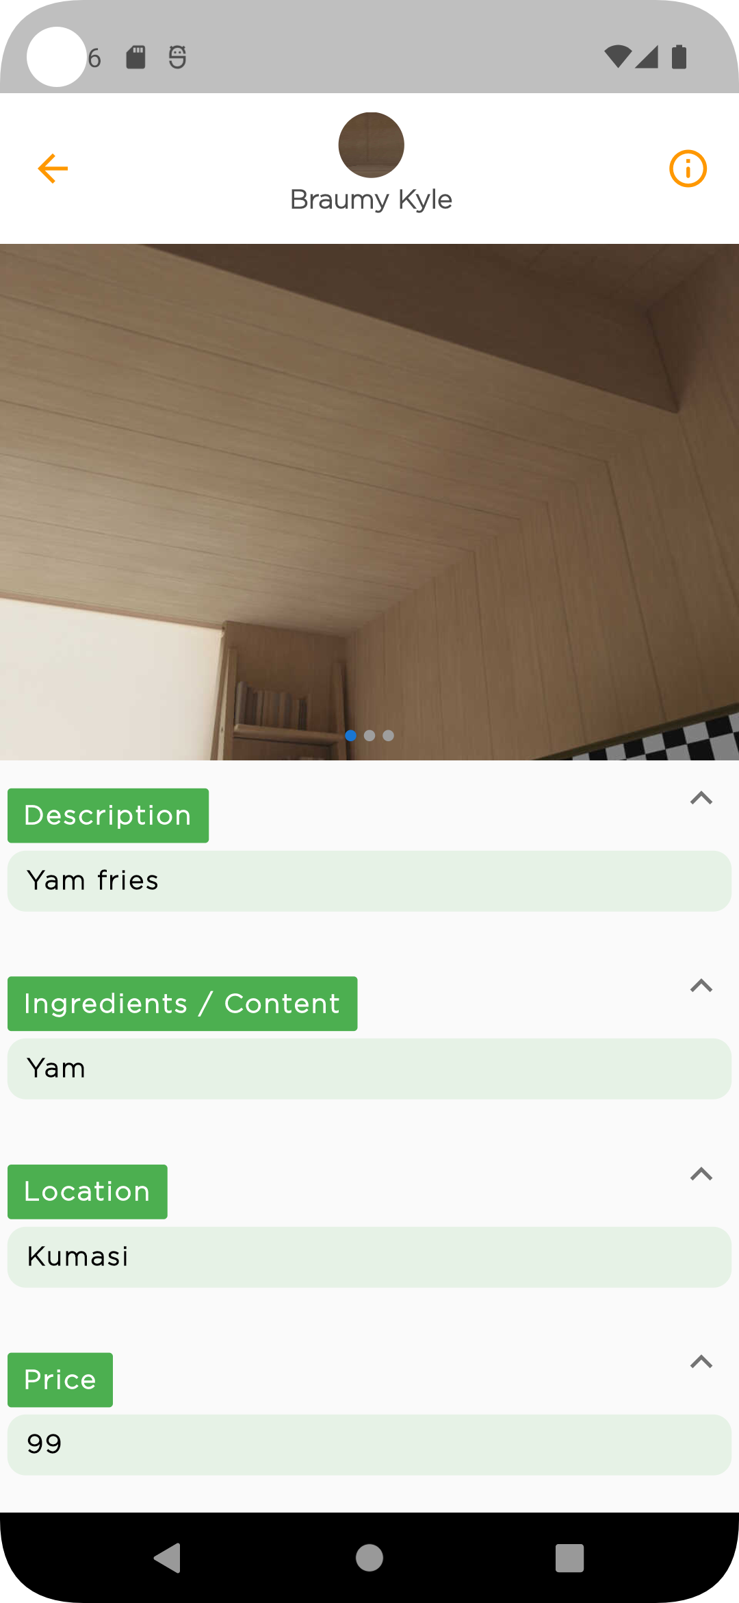
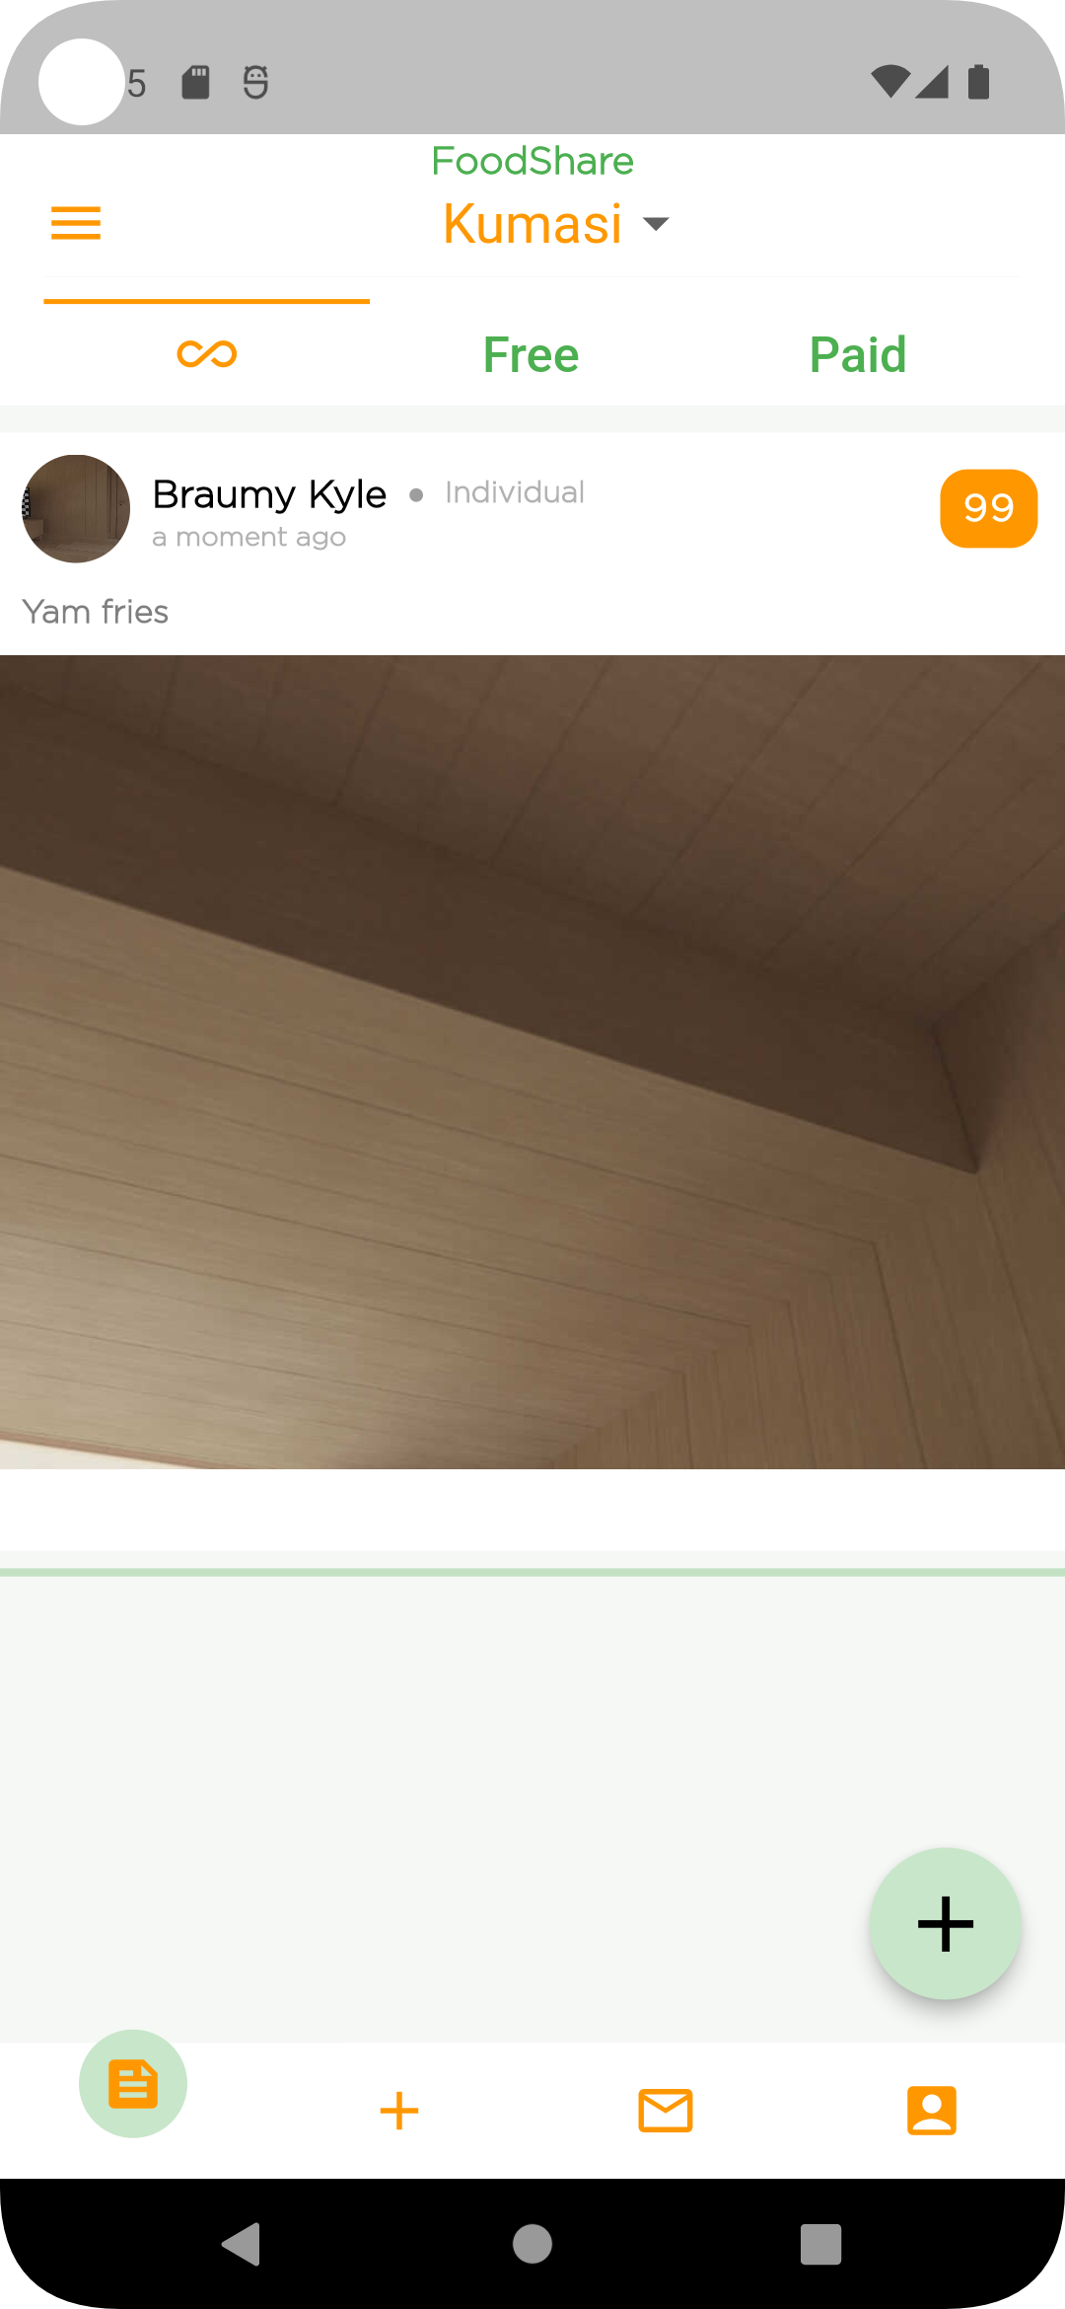
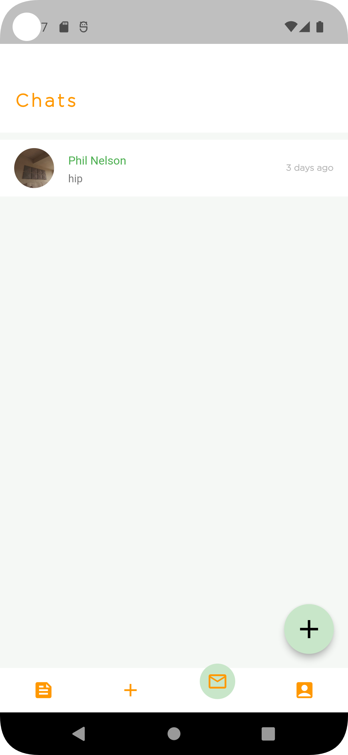
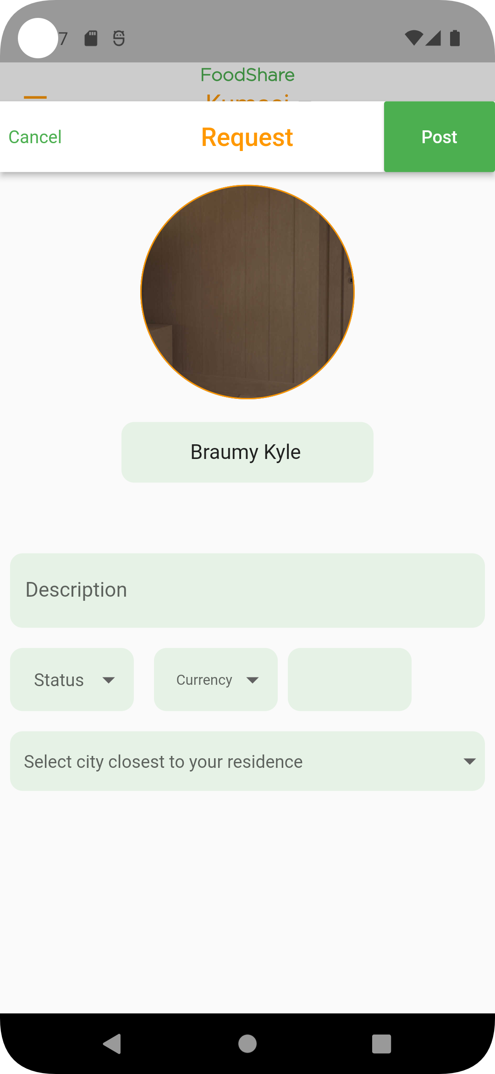
Snapshots of the app

Slide 11
Tests & Evaluation
The system was tested and the users provided the following feedback :
They enjoyed how easy the software was to use.
Its user interface is friendly.
Amazing in-app communication capabilities.
The ability of the user to influence the system intrigued them.
For them, the ability to request meals or specific food products was a wonderful advantage.

Slide 12
Conclusion
This study was motivated by the alarming rates of global hunger crisis as well as food waste.
The creation of this system has demonstrated its potential as an effective software tool for using cutting-edge technology to fight famine and global food waste.

Slide 13
References
https://www.epa.gov/recycle/preventing-wasted-food-home
https://www.wfp.org/global-hunger-crisis
https://www.unep.org/thinkeatsave/get-informed/worldwide-food-waste

Slide 14
THANK YOU!

